Slide 1
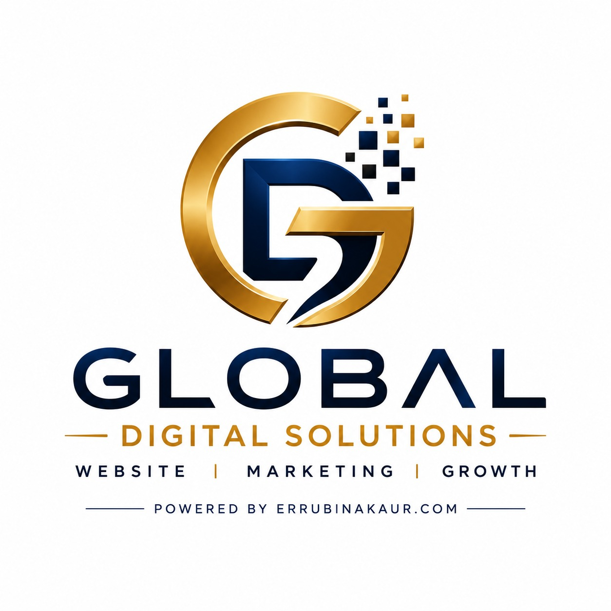

Slide 2
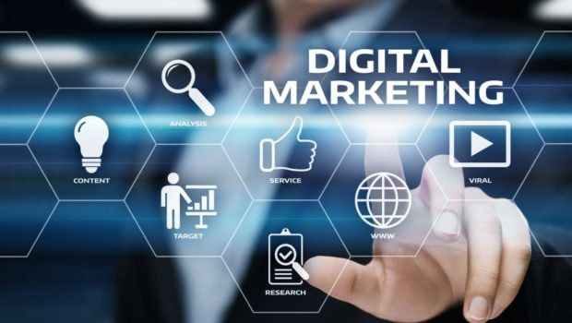
COMPANY PROFILE
We help businesses grow online with creative, result-driven digital marketing solutions. Our goals is to increase your brand awareness, generate quality leads and boost sales through effective online strategies.

Slide 3
OUR SERVICES
CONTENT CREATION
GOOGLE ADS & META
VIDEO EDITING & REELS
BRANDING & LOGO DESIGN
  SOCIAL MEDIA MARKETING
SEARCH ENGINE OPTIMIZATION (SEO)
EMAIL &WHATSAPP MARKETING
WEBSITE DESIGN & DEVELOPMENT

Slide 4
WHY CHOOSE US ?
AFFORDABLE PRICING
TARNSPARENT REPORTING
CREATIVE & PROFESSIONAL
COUSTOMER-FOCUS SUPPORT
RESULTS- ORIENTED APPROACH
CUSTOMIZED MARKETING STRATEGIES

Slide 5
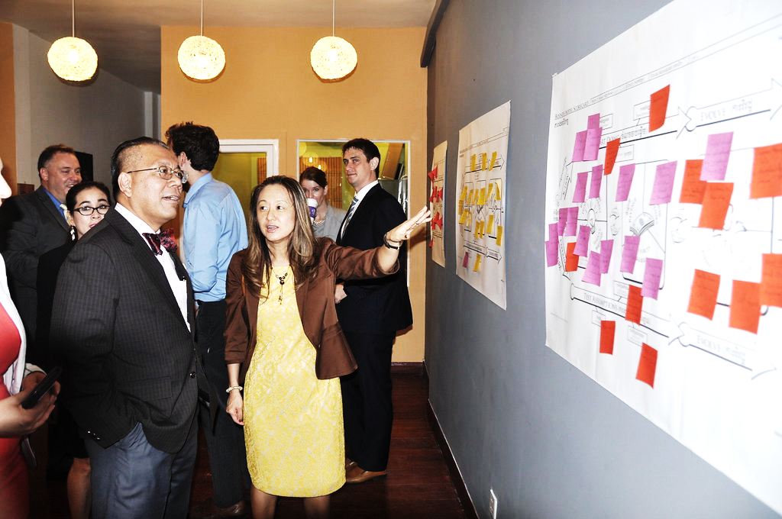
OUR MISSION
TO HELP BUSINESSES BUILD A STRONG ONLINE PRESENCE AND ACHIEVE SUSTAINABLE GROWTH THROUGH INNOVATIVE DIGITAL MARKETING SOLUTIONS.

Slide 6
ABOUT US
At GNIT, We are passionate about helping businesses grow through innovative digital marketing solutions. Our team specializes in Social Media Marketing, SEO, Google Ads, Meta Ads, Content Creation, Graphic Design,
Website Development, and Branding.
We Believe every business deserves a strong online presence. That’s why we create customized marketing strategies that increase brand awareness, generate quality leads, and drive real business growth.
Our focus is on creativity, transparency, timely delivery, and customer satisfaction. We are committed to building long – term relationships by delivering high-quality services and measurable results .
Your Growth is Our Success.

Slide 7



CONTACT US
Have a question or want to place an order ?
We’d love to hear from you!
PHONE: 9501966548 , 8437629825
errubinakaur@gmail.com
errubinakaur.com

